Slide 1
Chapter 8.1
Introducing gases

Slide 2
Every day, we use gases for many purposes, e.g. adding fizz to soft drinks, liquefied petroleum gas(LPG) to fuel motor vehicles and natural gas for cooking and heating.
Air
Air is a mixture of many substances. The main gases are nitrogen, oxygen, argon and carbon dioxide. The amount of these gases are remarkably constant throughout the atmosphere. Air contains water vapour, but its % varies considerably from close to 0% in dry desert air to 5-6% in air above a tropical rainforest.

Slide 3
The concentrations of some substances are measured in parts per million(ppm) by volume. This measure is used when concentrations involved are very small.
E.g. 350 ppm corresponds to a percentage concentration of 0.0350%.
Parts per million can also be used for weight / weight (w/w) comparisons.
Volume of a gas sample varies with temperature and pressure, if gas volumes are to be compared, then they must be measured at the same temperature and pressure.

Slide 4
Gas pressure
Gases consist of particles in constant motion and the gas particles are a long way apart. When the gas particles collide each other they exert a pressure.
Gas pressure is the measure of the force per unit area.
The international system of units (SI) unit of gas pressure is the pascal (Pa) and is equivalent to a force of 1 newton per square metre.

Slide 5
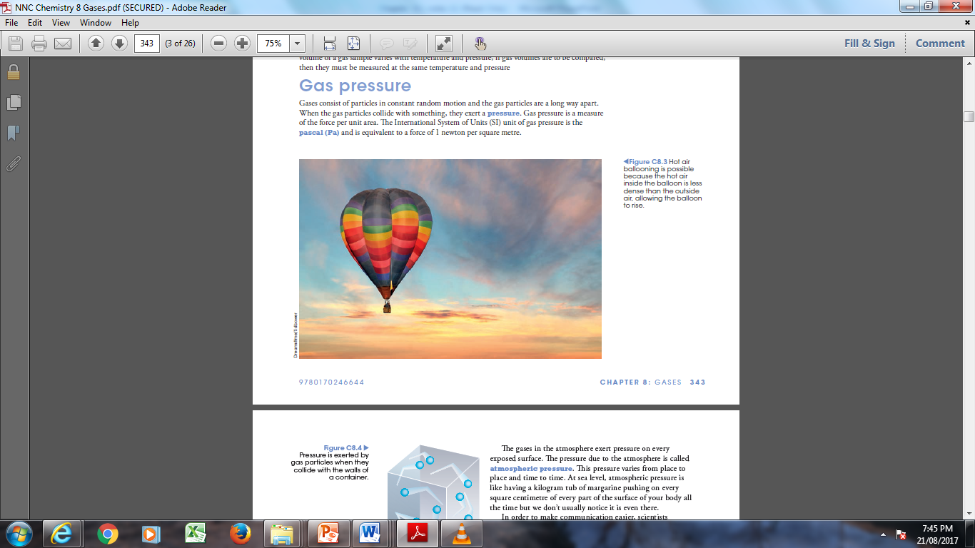

Slide 6
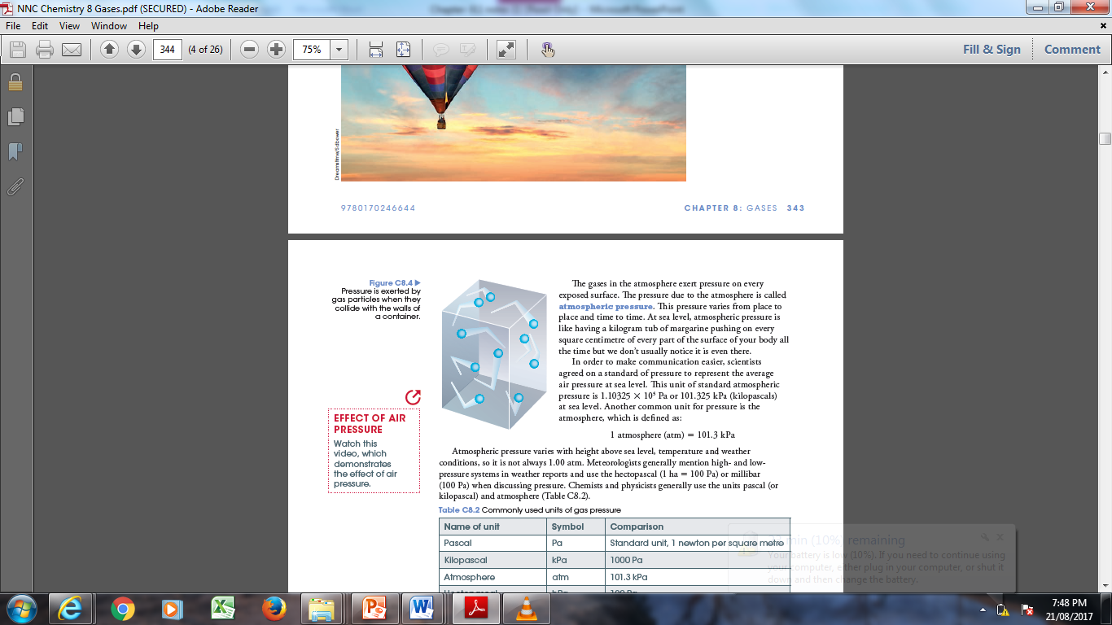
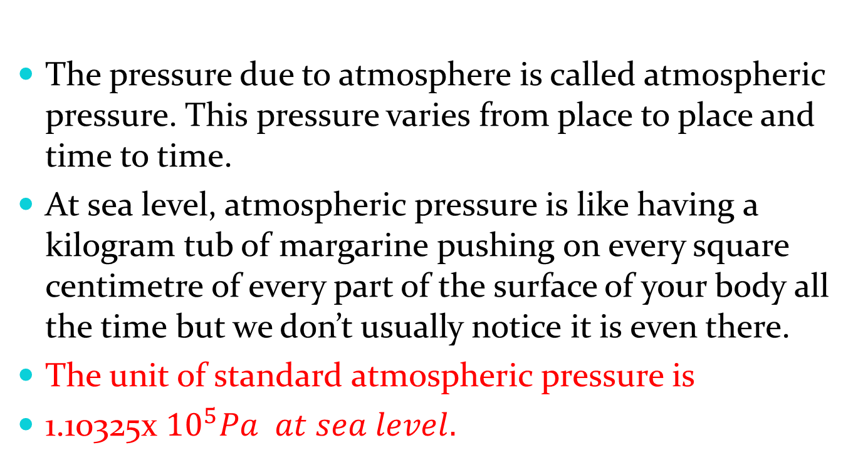
The pressure due to atmosphere is called atmospheric pressure. This pressure varies from place to place and time to time.
At sea level, atmospheric pressure is like having a kilogram tub of margarine pushing on every square centimetre of every part of the surface of your body all the time but we don’t usually notice it is even there.
The unit of standard atmospheric pressure is
1.10325x ${10}^{5}Pa at sea level.$

Slide 7
Another common unit for pressure is the atmosphere.
1 atmosphere (atm) = 101.3kPa
Atmospheric pressure varies with height above sea level, temperature and weather conditions, so it is not always 1.00 atm. Chemists and physicists generally use the units pascal and atmosphere.
https://www.youtube.com/watch?v=4nDkWnilyWM

Slide 8
Name of unit | Symbol | Comparison
Pascal | Pa | Standard unit, 1 newton per square metre
Kilopascal | kPa | 1000Pa
Atmosphere | atm | 101.3 kPa
Hectopascal | hPa | 100Pa
Millimetres of mercury | mmHg | 760mm Hg = 1 atm

Slide 9
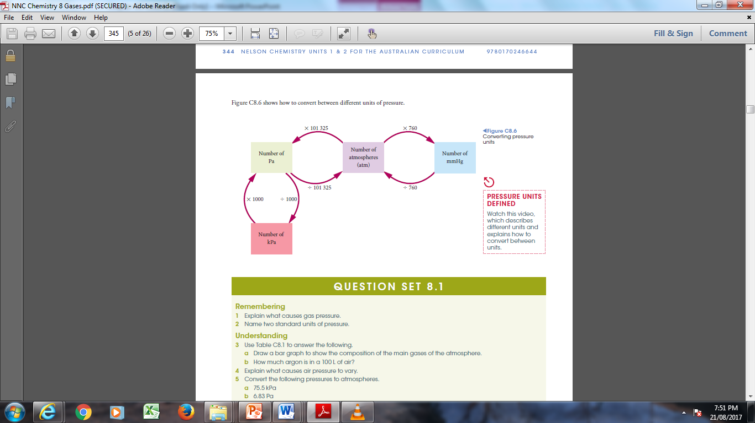

Slide 10
Do Question Set: 8.1 Q: 1-6 Page: 345 Nelson Unit 1&2

